Slide 1
Slag Valorisation Symposium
Mechelen 02. April. 2019
Towards Red mud Valorisation:
EAF Smelting process for iron recovery and slag design for use as precursor in the construction industry
B. Xakalashe, B. Friedrich

Slide 2
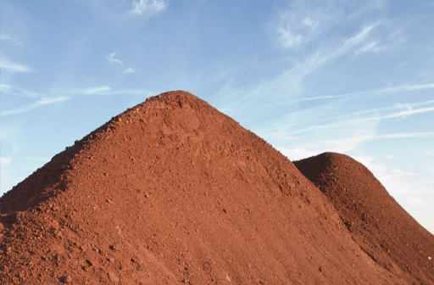
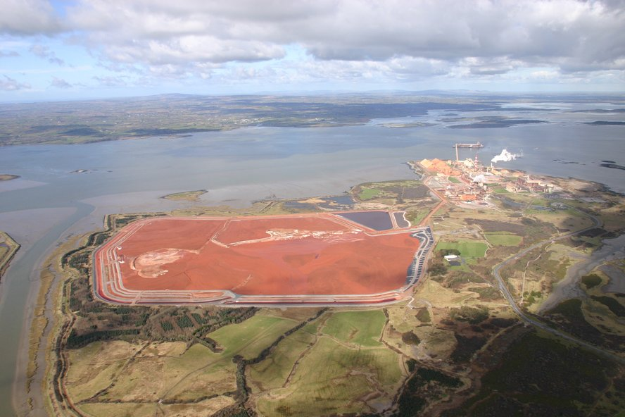
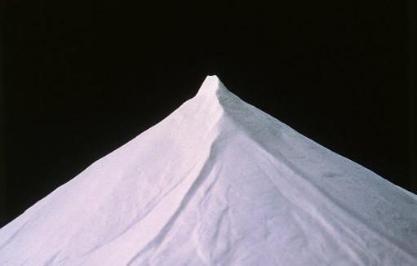
Bayer Process – Generation of Red Mud
Digestion
Clarification
Bauxite ores
30-54% Al₂O₃
Precipitation
Production:
>150 x 10⁶ Mt/year
Stock: 4 x 10⁹ Mt
Calcination
Alumina

Slide 3
Red Mud – Resource and Challenges
Potential resource of valuable elements
Challenges:
Generation of residue during extraction
Low reactivity
Leaching of heavy metals
UP
Components | Fe₂O₃ | Al₂O₃ | CaO | SiO₂ | TiO₂ | Na₂O
Typical range (wt.%) | 5- 60 | 5-30 | 2-14 | 3-50 | 0.3-15 | 1-10
Trace elements: As, Be, Cd, Cr, Cu, Ga, Hg, K, Mn, Pb, REEs, Sc, Th,
U, V, Zn, REEs

Slide 4
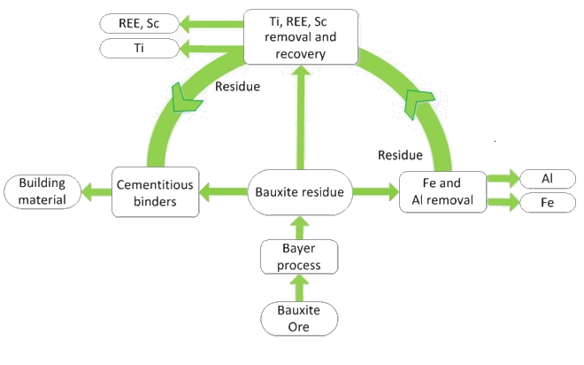
Zero Waste Valorisation of Red Mud
IME
Alumina
Horizon 2020: MSCA–ETN Redmud
“European Training Network for Zero-waste Valorisation of Bauxite Residue (Red Mud)“
http://etn.redmud.org/

Slide 5
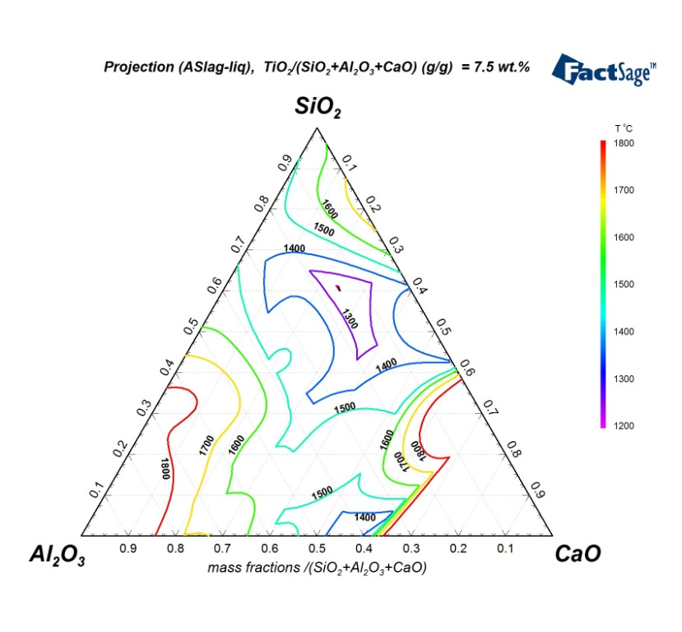
EAF Smelting Process
Red Mud (MYTILINEOS Aluminium of Greece)
Component | Fe₂O₃ | Al₂O₃ | CaO | SiO₂ | TiO₂ | Na₂O | Cr₂O₃ | V₂O₅
Wt.% | 43.5 | 24.0 | 10.2 | 5.5 | 5.6 | 2 | 0.4 | 0.1
3C + Fe₂O₃ = 2Fe + 3CO
Fe recovery to metal phase
High melting slag
Fluxing
Lower operating temperatures
Fluid slag
Silica sand: aluminosilicate, vitreous slag
(Inorganic polymer)
Lime: calcium aluminate, crystalline slag
(cement clinker)
Silica fluxing
lime fluxing
RM

Slide 6
Experimental Procedure – EAF Smelting
100 kW DC furnace
Operated (3-6kW)
Batch mass:1.5kg Red Mud
Lignite Coke: 0.1 x Red Mud
(Reducing agent)
Silica sand: 0.2 x Red Mud
Lime: 0.4 x Red Mud
Operating Temperature: 1500 – 1550ºC
Holding Time: 1 hour
Slag cooling: Slow - 30ºC/min
UP
slag
Pig Iron
(Fe)

Slide 7
Silica Fluxed Slag
Fe removal achieved
Vitreous slag achieved UP
Components | Fe₂O₃ | Al₂O₃ | CaO | SiO₂ | TiO₂ | Na₂O
RM (wt.%) | 43.5 | 24.0 | 10.2 | 5.5 | 5.6 | 1.8
Slag (wt.%) | 1.2 | 36.8 | 15.3 | 38.0 | 7.3 | 2.4
Silica fluxed slag
Intensity (A.U.)
Red Mud

Slide 8
Lime Fluxed Slag
Fe removal achieved
Crystalline slag achieved UP
Components | Fe₂O₃ | Al₂O₃ | CaO | SiO₂ | TiO₂ | Na₂O
RM (wt.%) | 43.5 | 24.0 | 10.2 | 5.5 | 5.6 | 1.8
Slag (wt.%) | 0.6 | 31.5 | 53.9 | 8.9 | 6.2 | 0.5
Silica fluxed slag
Intensity (A.U.)
Red Mud

Slide 9
Metal Analysis
High recovery of Fe, Cr, V achieved (cleaning)
Low Si and Ti recovery
Pig iron can be used in secondary steel making
Pig iron caUP
Component | Fe | C | Si | Ti | Cr | V | P | S
Silica fluxed | 91.8 | 5 | 1.7 | 0.3 | 0.5 | 0.2 | 0.1 | 0.03
Recovery | high | - | low | low | high | high | - | -
Lime fluxed | 93 | 5.1 | 0.1 | 0.3 | 0.5 | 0.2 | 0.2 | 0.01
Recovery | high | - | low | low | high | high | -

Slide 10
Synergistic Waste Treatment with Red Mud
MSWI BA: Municipal Solid Waste Incineration bottom ash
Waste produce around all EU
20 million tonnes/year
It’s a SiO₂-CaO-Al₂O₃ acid slag (rich in silica ~50%)
BOF: Basic Oxygen Furnace Slag (from Steel making)
Waste produce around all EU
10 million tonnes/year
It’s mainly CaO-FeO basic slag (rich in CaO ~40%)

Slide 11
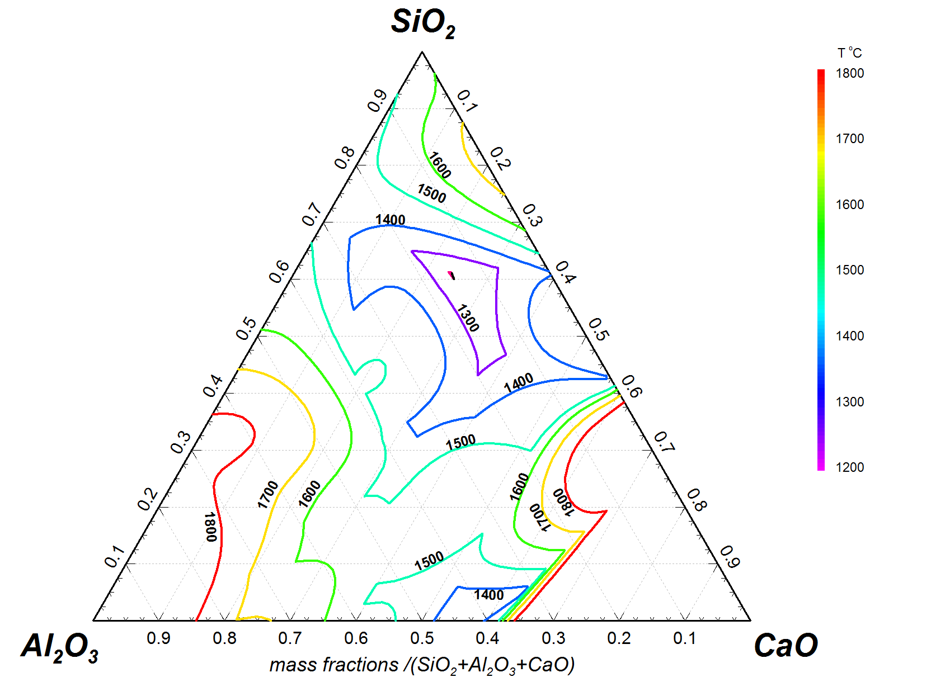
Synergistic waste treatment with Red Mud
Vitrified MSWI Bottom Ash
Amorphous
Low melting point
MSWIBA
Highly amorphous
Acidic slags
Highly crystalline
Low melting point and low viscosity
Combined recovery of Iron (BOF+RM)
BOF
RM
Basic slags

Slide 12
Conclusions
Red mud was successfully smelted for iron recovery and conditioning of slag
Cleaning of the mineral phase (slag) was achieved
Production of a vitreous slag under silica fluxing was achieved
Production of a crystalline slag enriched in calcium aluminate phases was demostrated
Utilisation of the produced mineral phase in the construction industry could lead to zero waste valorisation of red mud
UP

